Slide 1

We are proud to present our “Thermo-Solar” system
How Sun-Radiation is used for Boiler’s water pre-heating

Slide 2

Who is “Sun Power Engineering” ltd
“Sun Power Engineering” ltd, is an Israeli registered company.
Our team of Engineers, is Experienced & Specified, world-wide well connected in Thermo-Solar Energy, sophisticated systems.
Specialized in ‘Tailor-Made’ and ‘Tuen-Key’ project services.
We are under Joint-Venture agreements & supply with 2 international huge companies, with over 20 years of Experience in the Thermo-Solar field.
Our people have a great ambitus in doing better for Business and Environment.

Slide 3


One of our life Philosophy say’s:
All along every morning Sun is Shining, and We can use it for Free
Don’t hesitate and use it for:
Monetary Saving and Environment Improving
If you agree with this philosophy, follow us, and:
Think & make-up your mind for next step of Improvement
(Not using it, is your Net Lost)

Slide 4

Boiler generates us Steam for Cooking and Sterilizing
For Steam generating, we’re Burning Materials (Gasoline, Gas, Charcoal, etc.)
Burning these Materials, means:
our Money ‘Buring’, and Air Pollution creating
Adding your Boiler our Solar-Energy system,
will make the Big Change

Slide 5
How is our “Thermo-Solar” system working…..?

Slide 6
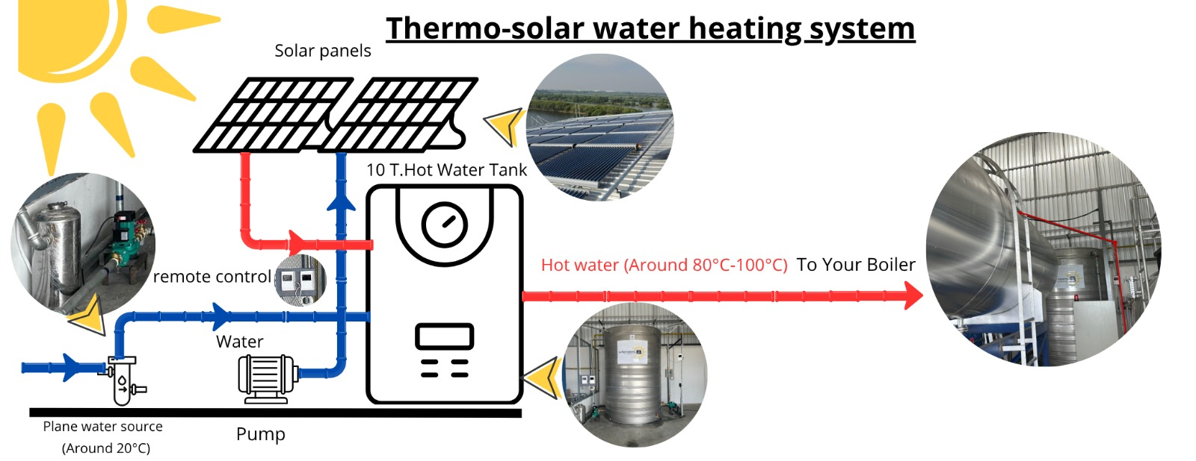
As an idea, it’s very simple:

Slide 7
Is it really working ……..?

Slide 8
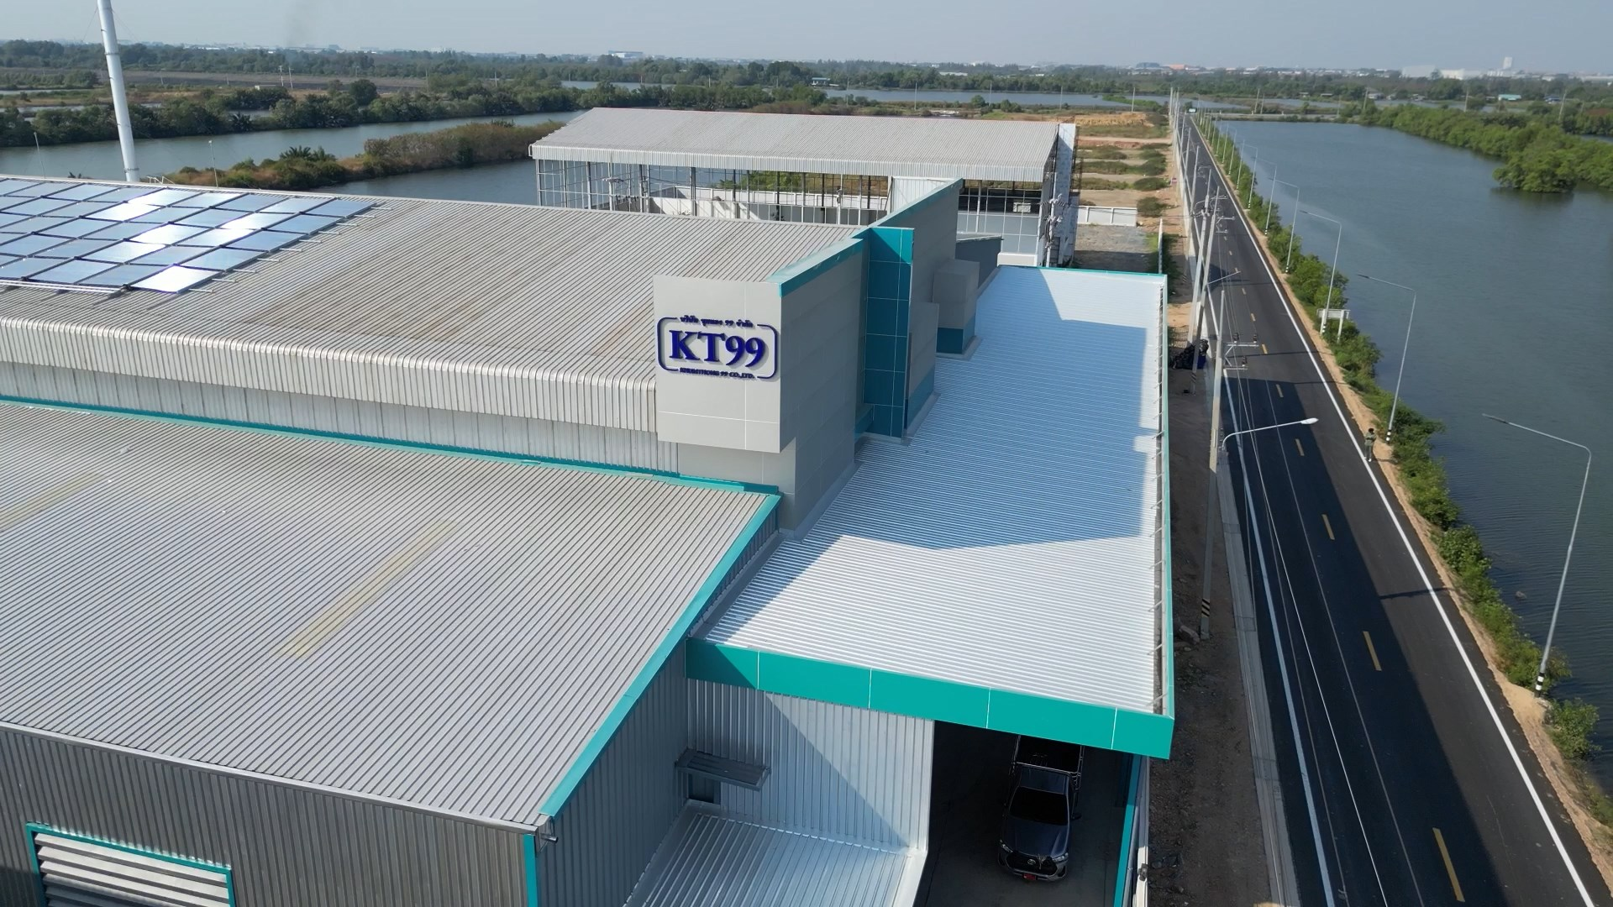
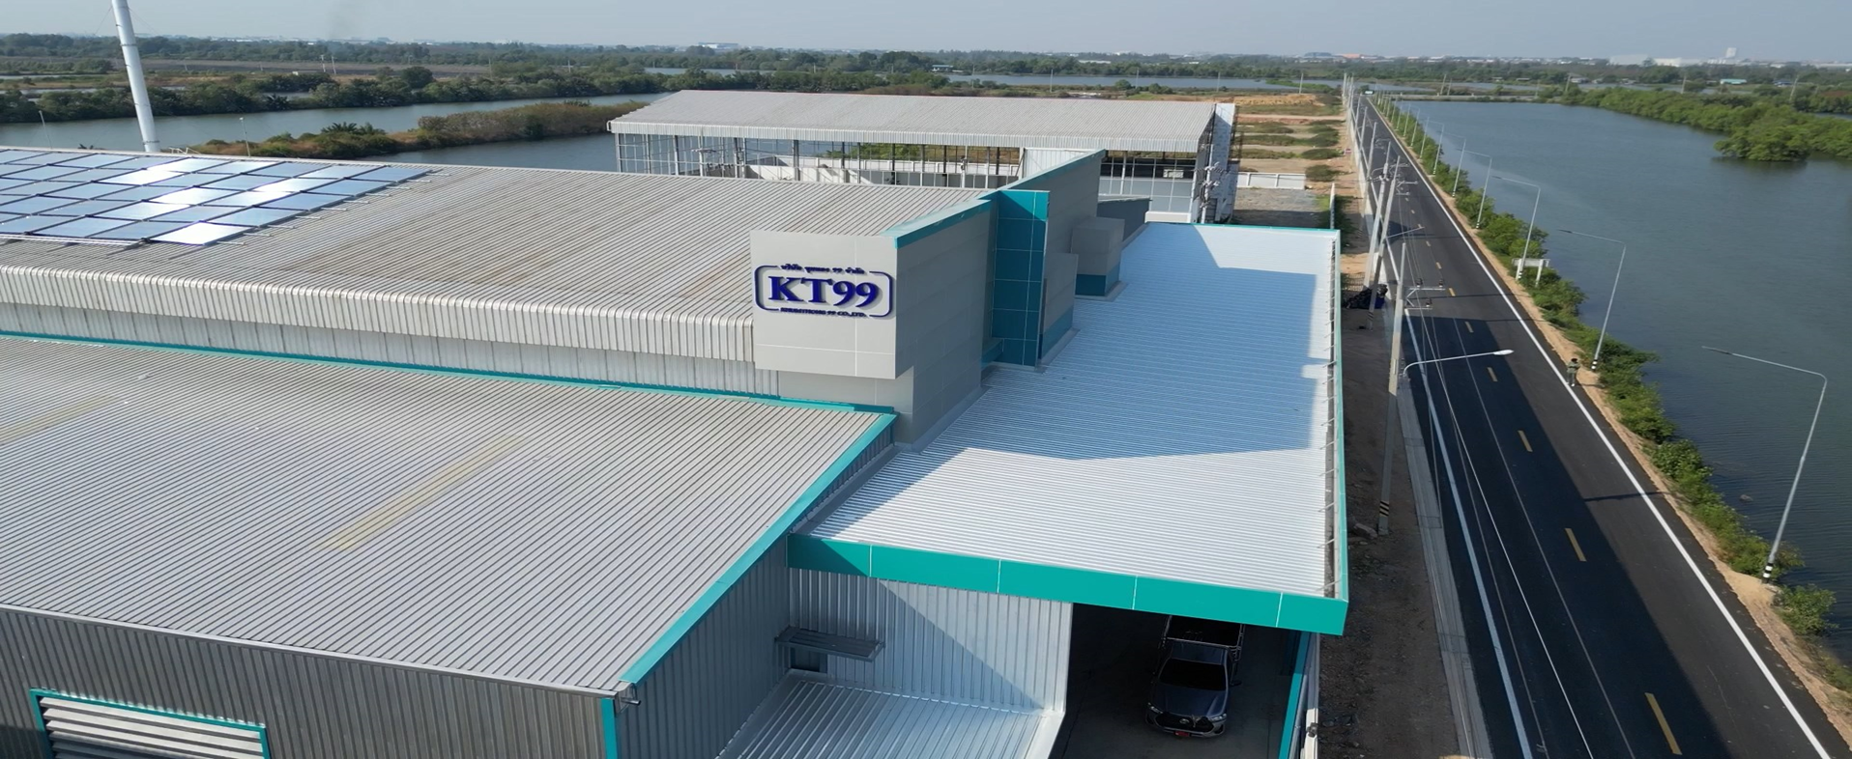
Yes, Here in Samut Sakhon:

Slide 9
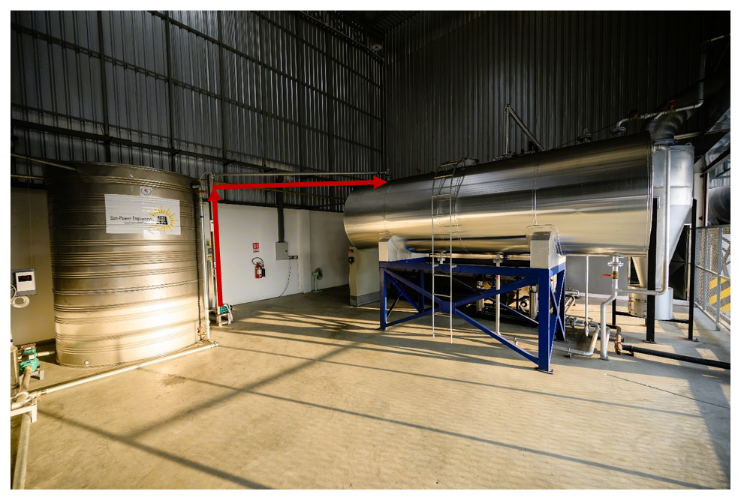
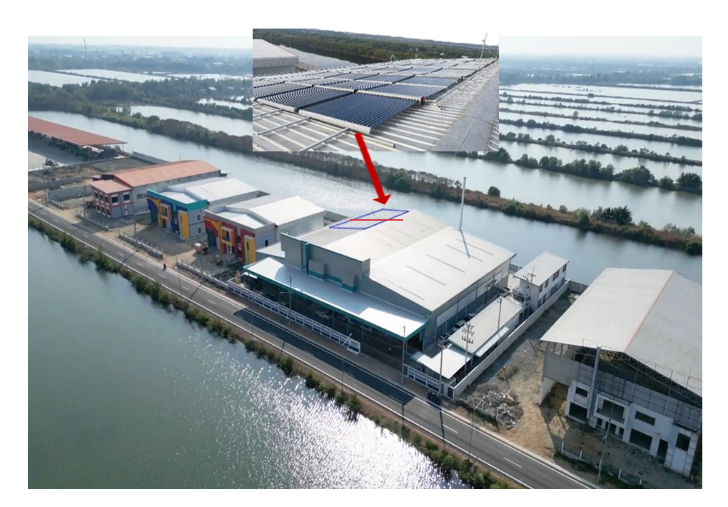
From 10Ton Hot water Tank transferred to Boiler Solar Panels, from above

Slide 10
KT 99 Owner (Tuna caning Factory):
“ Around Mid of December 2024, The “Solar system” had been installed in my new Tuna caning factory, (It took 4 days to install) and started to function on the same day”
“To the Gasoline tank, was connected an Electronic meter, for accurate Gasoline litters counting”
“After 4 weeks of carefully and precise monitoring, by ourselves, each of the systems (Regular VS Solar), The Results clearly shows the Saving of 33.5%(!) of Gasoline, by the Solar system using”, Testified the Owner.

Slide 11
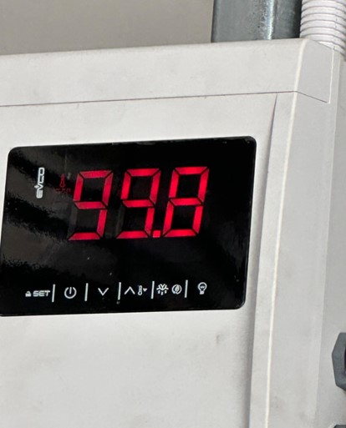
What is the Change doing……?
Today, Water supplied to Boiler is 20°C - 30°C
By adding Our “Thermo-Solar” System to Boiler:
Boiler’s Hot water supply will be 80°C up to 95°C (and more)
(During monsoon time: 60°C up to 75°C )
This Change, creates the
Strong & Enough Reason for Solar System Using !

Slide 12
What are the requirements saying……….?
Daily Steam feeding 6 – 8 Retorts, needs supply of:
Each 1 hour: 1.25 Ton of Steam
Working hours a day: 10 hours
Total steam for each working day: 12.5 Tons

Slide 13
Engineer's calculations shows the need of:
Solar Panels area: 350 m²
Accumulating Hot water Tank: 10 Tons
Sun Irradiation for Hot water Generating: 7 hours a Day

Slide 14
Based on our ‘Tailor made’ and ‘Turn Kye’ Services
Therefore, our supply will include:
350 m² of Solar Panels
10 Ton Isolated Hot water accumulating Tank
Control panel (including Wi-Fi)
3 water Pumps, Water filter, Set control valves, Control & Safety units
Isolated pipeline
Complete, at site, System Installing
1 year of warrantee contract
Continues Service: by our Thai local team

Slide 15

Why “Solar System” Purchasing is it an Intelligent decision?
Up to 40% of Energy Sources (Money) Saving for same Steam
production!
Fast R.O.I.: 12 -14 months (about)
Estimated lifetime: 10 - 15 years
Silent & Clean working system
Almost No maintenance need
From Far Monitored & Controlled 24/7
Deserves the Receiving (Tax reduction, Support for system purchase)

Slide 16

July 2nd, 2025
Thanks for your kind attention
Dr. Menashe Rosenfeld

